Slide 1
Rhinitis, Rhinosinusitis, and Sinusitis
AHAD 1
Gabrielle Heil, MN, NP

Slide 2
Rhinitis
Definition:
Risks:
Symptoms:
Signs:
Physical Examinations:
Confirmatory Diagnostics:

Slide 3
Rhinitis
Definition: inflammation of the nasal turbinates
Risks: allergies, infection exposure, NSAID use, nasal corticosteroid discontinuation
Symptoms: rhinorrhea, sneezing, nasal stuffiness and blockage
Signs:
Physical Examination findings:
Confirmatory Diagnostics: Only if initial management is not successful
  Nasal smear for infection (neutrophils, bacteria) or allergic (eosinophils)/allergy testing
  Infection: CRP
  Allergies: allergy testing
Allergic | Infectious
Nasal mucosa pale & boggy Clear rhinorhea, watery mucous Associated allergic sequelae (e.g. allergic conjunctivitis) | Nasal mucosa erythematous & swollen Purulent discharge (yellow/green) Fever possible Other viral symptoms associated
Notes:
What other physical examinations will you do when someone presents with these symptoms?
Why?

Slide 4
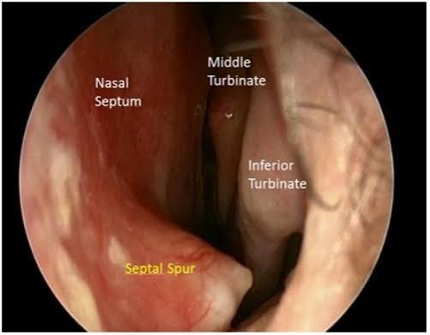
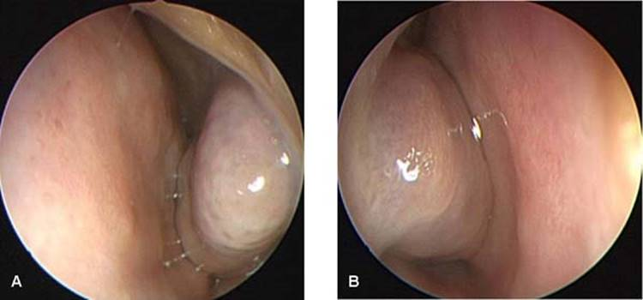
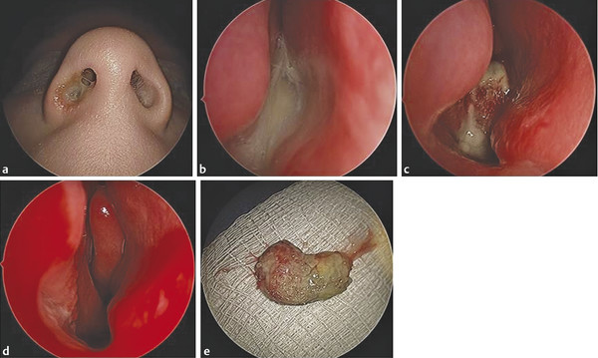
Allergic Rhinitis
Infectious Rhinitis
Notes:
Septal spur is not always present; a normal variant

Slide 5
Acute Sinusitis
Definition:
Risks:
Symptoms:
Signs:
Physical Examinations:
Confirmatory Diagnostics:

Slide 6
Acute Sinusitis
Definition: inflammation of the frontal, maxillary, and/or ethmoid sinuses
Risks: smoking, recent URI, winter months
Symptoms:
Purulent nasal discharge (yellow/green), frontal headaches worse with forward bending, fullness/pressure feeling
Signs:
Physical Examinations:
  Decreased transillumination
  Palpation/percussion: localized tenderness to affected sinus, maxillary toothache
  Not listening for the sound associated with percussion, just tenderness or referred pain
  Vitals: fever
Confirmatory Diagnostics: None
Notes:
What other physical examinations will you do when someone presents with symptoms concerning for sinusitis? Why?

Slide 7
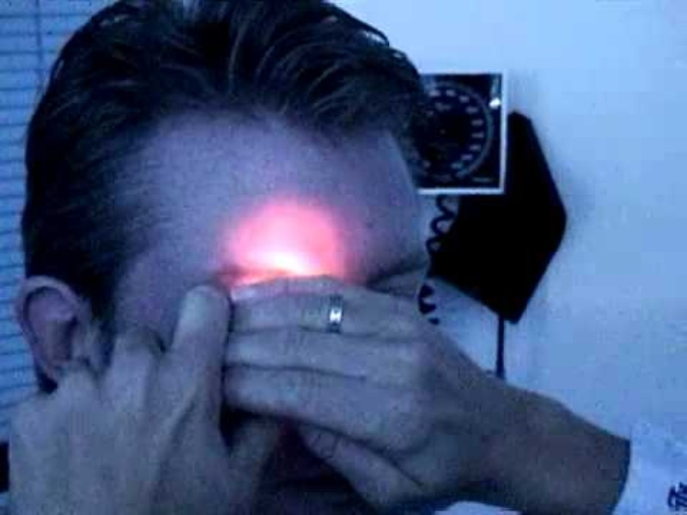

Slide 8
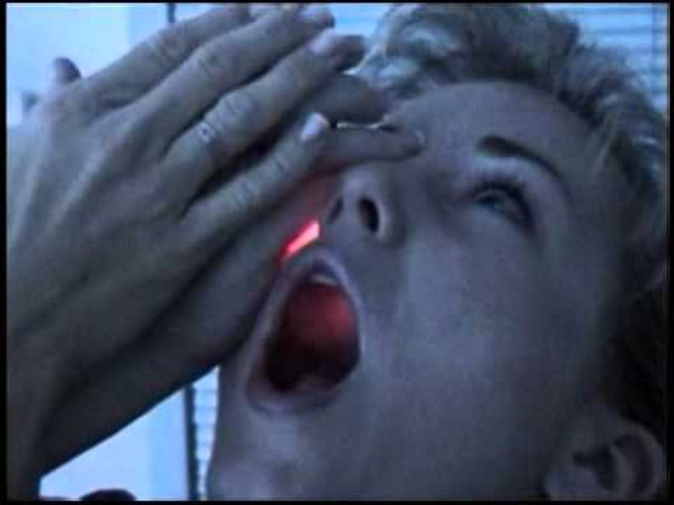

Slide 9
Viral vs. Bacterial Sinusitis
 | Viral | Bacterial (ADULT)
Timing | Largely resolves or markedly improved within 7 | No symptom improvement after 7 days OR worsening after 5-7 days
Symptoms | Associated with other viral sequelae: Rhinitis Pharyngitis Cough | 2+ major symptoms present: At least 1 of the major symptoms must include: Nasal obstruction, purulent nasal AND/OR pharyngeal discharge Other major symptoms: Facial pain/pressure/ fullness; hyposmia/anosmia
Severity | Lowe grade fever more common | High fever more common

Slide 10
Rhinosinusitis (the common cold)
A combination of sinusitis & rhinitis symptoms
When both exist, it is likely a viral cause, as the virus is contributing to the diverse sequelae
* Viral sinusitis may pave the way for bacterial sinusitis

Slide 11
Don’t Miss Diagnosis: Frontal Osteomyelitis
Definition:
Risks:
Symptoms:
Signs:
Physical Examinations:
Confirmatory Diagnostics:

Slide 12
Frontal Osteomyelitis
Definition: infection of the frontal bone
Risks: bacterial sinusitis associated with head trauma or scuba diving (staph pyogenes or anaerobic streptococci)
Symptoms: General severe malaise
Signs:
Physical Examinations:
  Appear very ill
  High fever
  Swelling over frontal bone
  Upper eyelid edema
Confirmatory Diagnostics: X-rays of sinuses & skull; blood cultures
* If suspected, referral to ED for the above tests urgently

Slide 13
